Slide 1

National Institute of Technology Patna
Department of Computer Science and Engineering
MINOR PROJECT - ||
WEED DETECTION APPLICATION
Presented by:​​
RIYA KUMARI (1806007)​​
ARUNIKA SHEETAL(1806021)​​
BABITA KUMARI(1806029)
Under the Supervision of:​​
Dr. RAJIB GHOSH
(Assistant Professor Grade-I)

Slide 2
INTRODUCTION
Farming is the foundation of Indian economy. It is a source of income for more than half of the Indian population. One of the serious issues in agribusiness is the control of weeds growing among the plantation crops. The term weed additionally is connected to any plant that develops or replicates forcefully. Weeds also require all essential nutrients that are required by plantation crops. Weeds if not checked may compete with other plantation crops for nutrients, space, water ,soil, and restrict their growth . Weeds play as host for plant pathogens which infect and degrade the quality of plantation crops. some weeds may also cause root damage to drainage pipes, road surfaces etc. Weed killers/herbicides are being sprayed all over the field to keep them under control . This technique is very inefficient because chemicals are being sprayed on plantation crops also, which leads to, polluting the environment and health problems in humans . To avoid these consequences, a smart weed control system should be deployed. The system must be capable of locating weeds in the field and alerting the farmers about exact locations of these weeds. So that herbicides are sprayed only in those locations . It focuses on reducing use of pesticides that harms the normal growth of plants. as well as serious health issues posed in humans.

Slide 3
ABSTRACT
In our project, we have focused on detecting the weeds in the crop using android application. We have first trained our model using convolution neural network by giving large images of weed and crop. Then this model is used in android application to detect whether the selected image is crop or weed.

Slide 4
DATASET
The dataset has been taken from Kaggle. This dataset was created by Alessandro dos Santos Ferreira, Hemerson Pistori, Daniel Matte Freitas and Gercina Gonçalves da Silva. It is distributed under the CC BY NC 3.0 license.
We have used total 8567 images in which there are 1191 weed images and remaining 7376 crop images.

Slide 5
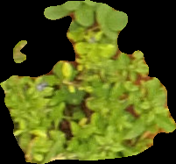
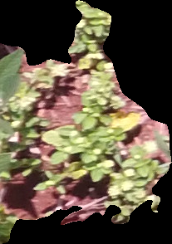
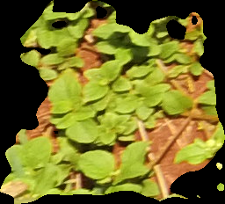
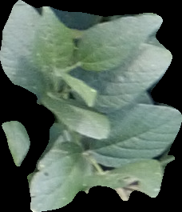
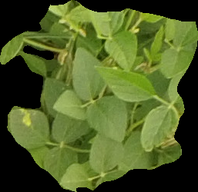
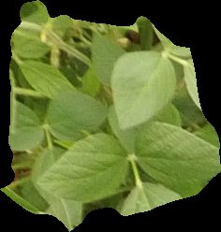
SAMPLE IMAGES
WEED
CROP
CROP

Slide 6
METHOD USED
For weed detection, Convolutional Neural Network is used in Jupyter Notebook.
For android application, Java programming language is used in Android Studio.

Slide 7
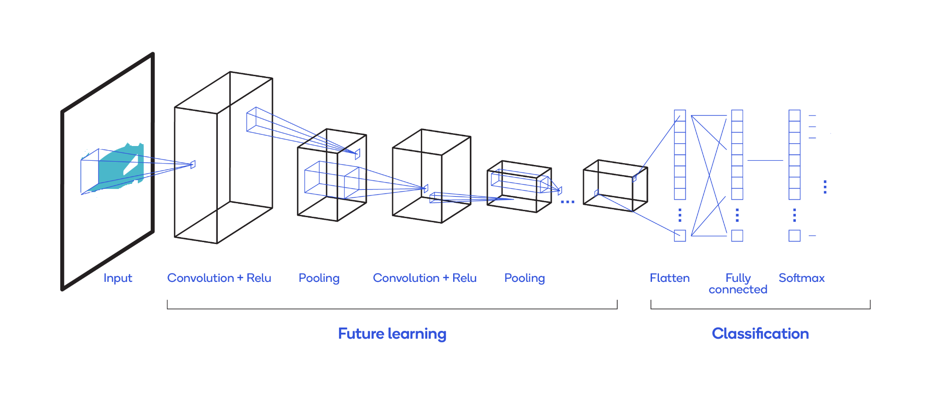
CNN ARCHITECTURE

Slide 8
CNN MODEL
No. Of CNN layers = 2 (Conv2D(64,(3,3),activation='relu'))
No. Of max pooling layers = 2
Dense layers = 1 (Dense(128, activation='relu'))
A convolution is a linear operation that involves the multiplication of a set of weights with the input. The multiplication is performed between an array of input data and a two-dimensional array of weights, called a filter or a kernel. The filter is smaller than the input data and the type of multiplication applied between a filter-sized patch of the input and the filter is a dot product. The output of one time multiplication is a single value.

Slide 9
The activation function here is ReLU.
After that, we’ve added a max pooling layer that halves the image dimension.
Max pooling selects the brighter pixels from the image. It is useful when the background of the image is dark and we are interested in only the lighter pixels of the image.
Then we’ve added 1 more of these layers together, with filters in CNN.
Finally, the CNN layer is flattened and sent to the output layer
The activation function here is softmax activation function.

Slide 10
ANDROID IMPLEMENTATION
Then we have deployed the deep learning model on the Android app using Java language.
Initially, we have converted the model to TFlite model.
Then we have imported the model in android studio and made a java class named- MainActivity.java
According to language.java class we have made an android xml file named- activity_main.xml

Slide 11
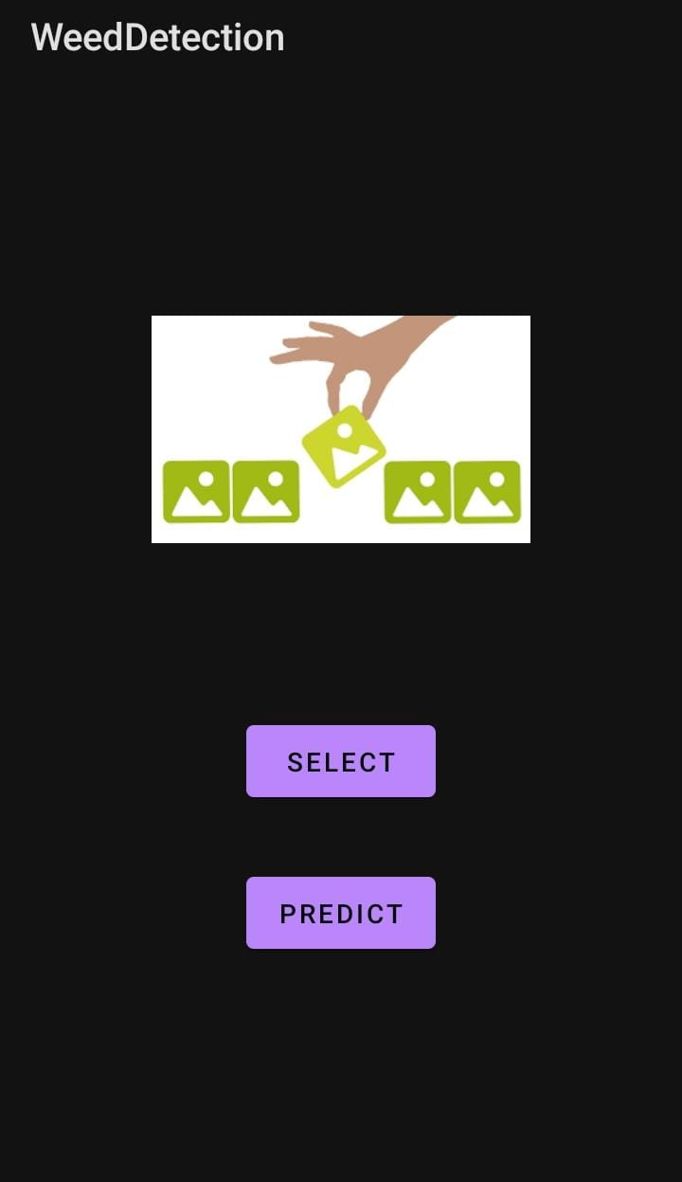
Under MainActivity.java we added two buttons i.e.,
Select: For selecting the input image. And
Predict: For predicting the image as weed or crop.

Slide 12
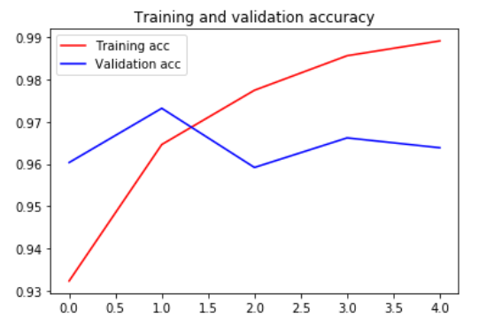
RESULT
Test
accuracy = 0.971
Training
accuracy = 0.989

Slide 13
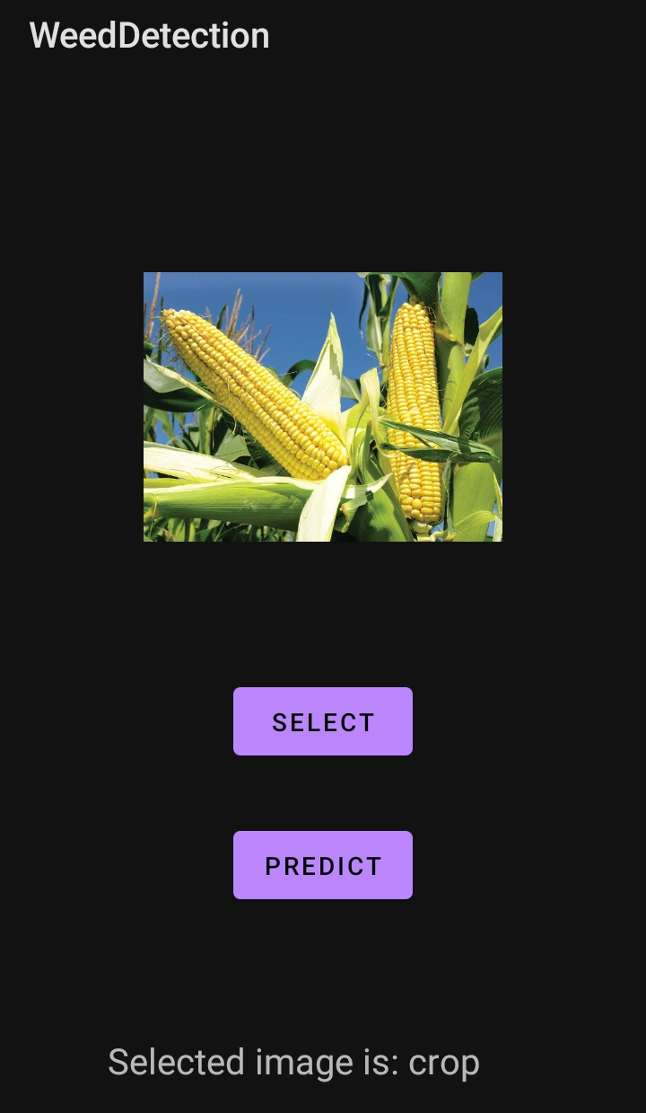
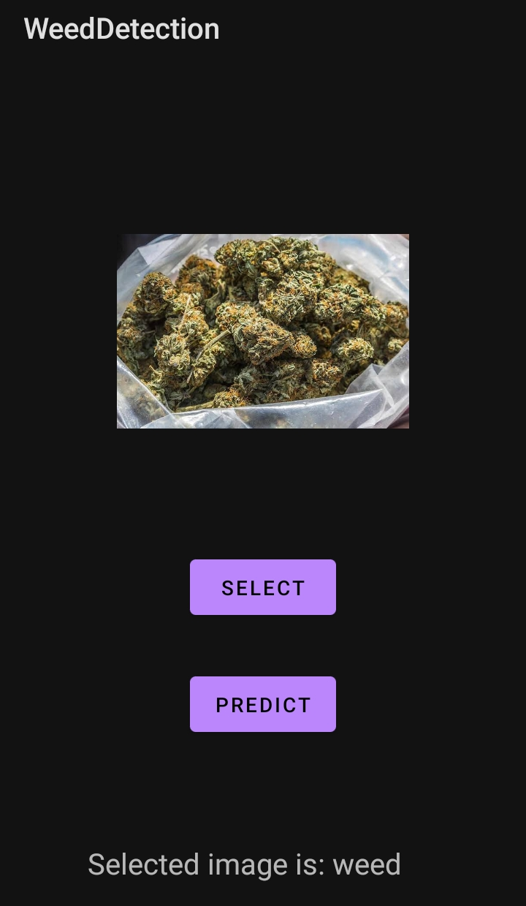
SCREENSHOTS

Slide 14
REFERENCES
[1] Khirade, S.D. and Patil, A.B., 2015, February. Plant disease detection using image processing. In 2015 International conference on computing communication control and automation (pp. 768-771). IEEE.
[2] Huang, W., Guan, Q., Luo, J., Zhang, J., Zhao, J., Liang, D., Huang, L. and Zhang, D., 2014. New optimized spectral indices for identifying and monitoring winter wheat diseases. IEEE Journal of Selected Topics in Applied Earth Observations and Remote Sensing, 7(6), pp.2516-2524.
[3] Perez, A.J., Lopez, F., Benlloch, J.V. and Christensen, S., 2000. Colour and shape analysis techniques for weed detection in cereal fields. Computers and electronics in agriculture, 25(3), pp.197-212.
[4] Burgos-Artizzu, X.P., Ribeiro, A., Tellaeche, A., Pajares, G. and Fernández-Quintanilla, C., 2010. Analysis of natural images processing for the extraction of agricultural elements. Image and Vision Computing, 28(1), pp.138-149.

Slide 15
Thank you!

